Slide 1


8086 Memory Interfacing
Presented by
Mahbubur Rahman
Lecturer
Department of Computer Science and Engineering(CSE)
Green University of Bangladesh(GUB)

Slide 2
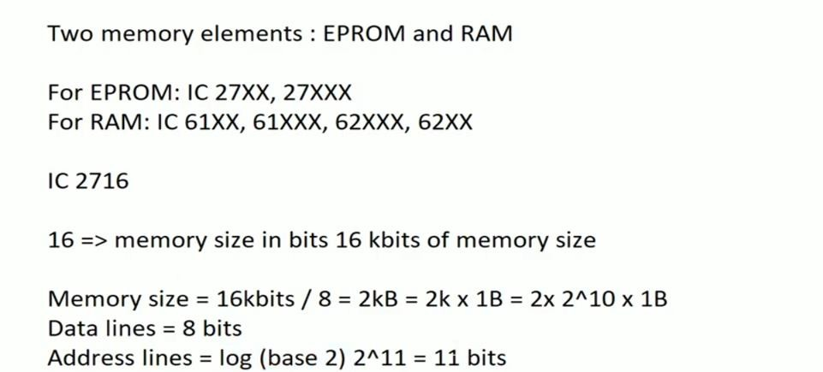
Memory Interfacing ( Chip Identification)

Slide 3
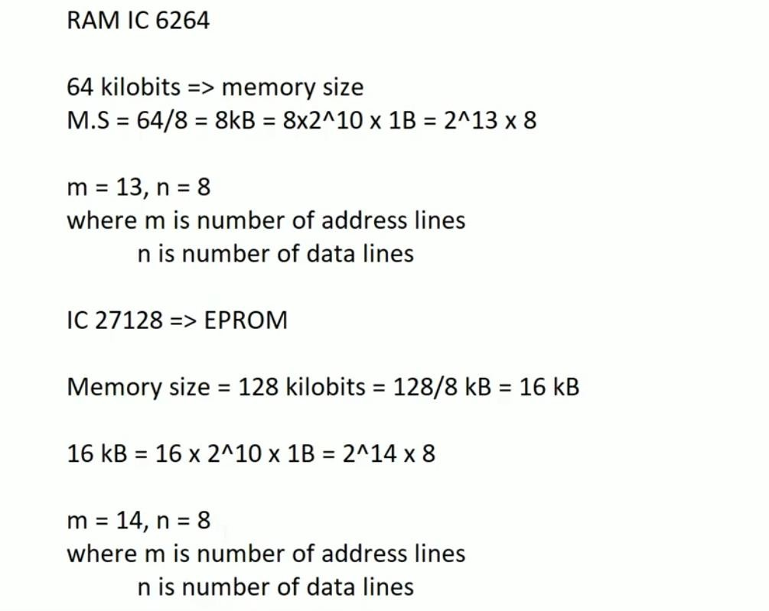
Memory Interfacing ( Chip Identification)

Slide 4
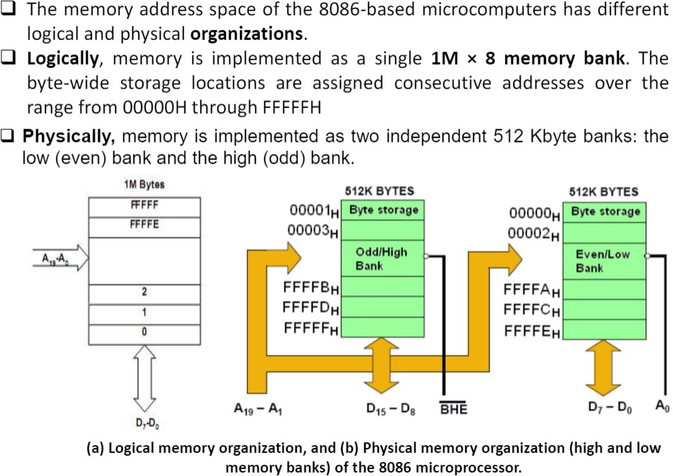
8086 Memory Organization

Slide 5
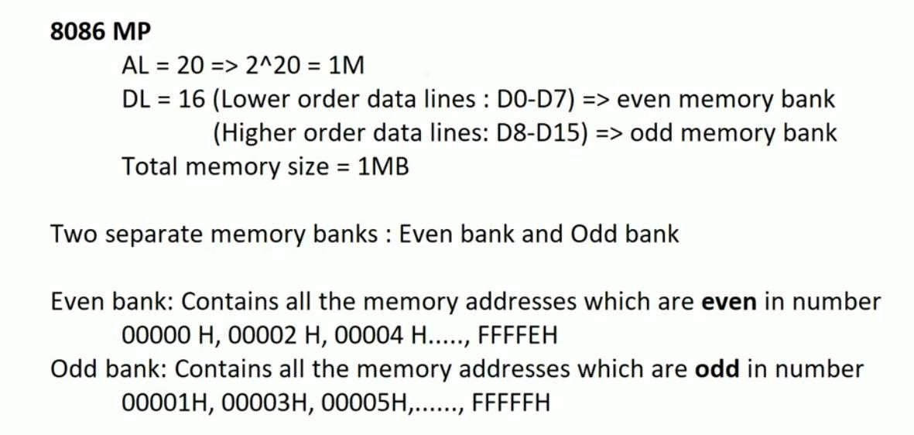
Memory Interfacing(Odd and Even Bank)

Slide 6
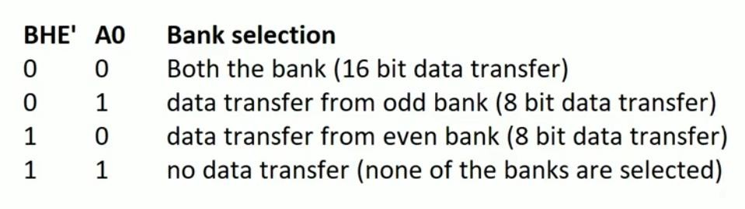
Bank Selection
To distinguish between odd and even bytes, the CPU provides a signal called BHE’ (bus high enable).
BHE’ and A0 are used to select the odd and even byte, as shown in the table below :

Slide 7
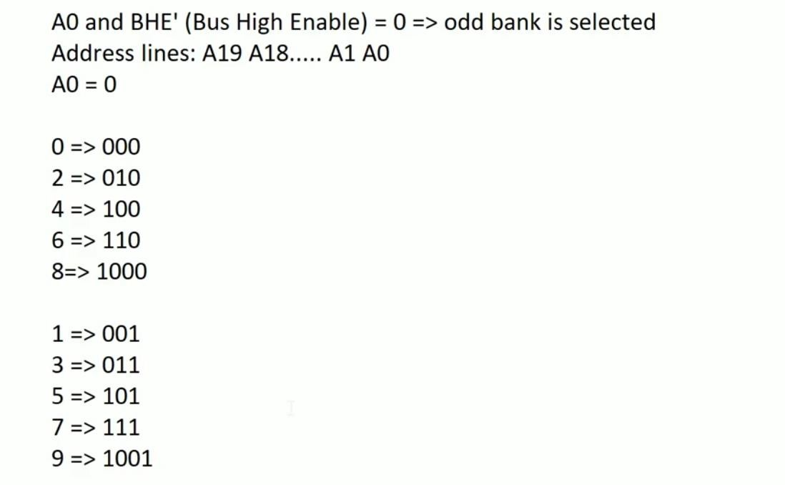
Memory Interfacing(Odd and Even Bank)
=> Even Bank is selected

Slide 8
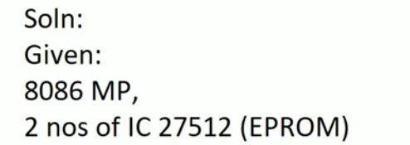
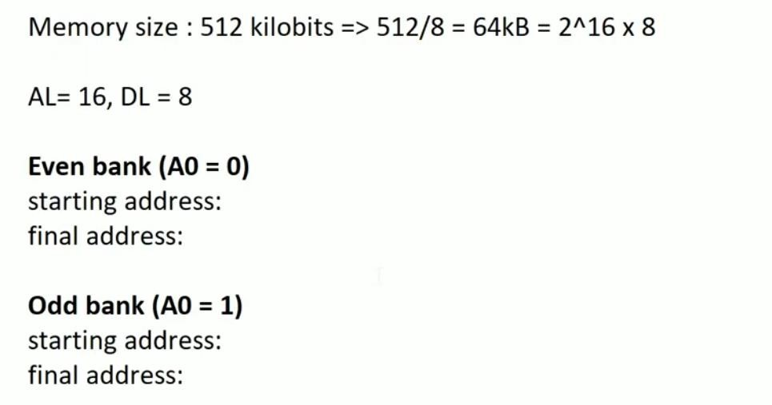
Exercise: 1
Interface microprocessor 8086 with two numbers of IC-27512 chip.

Slide 9
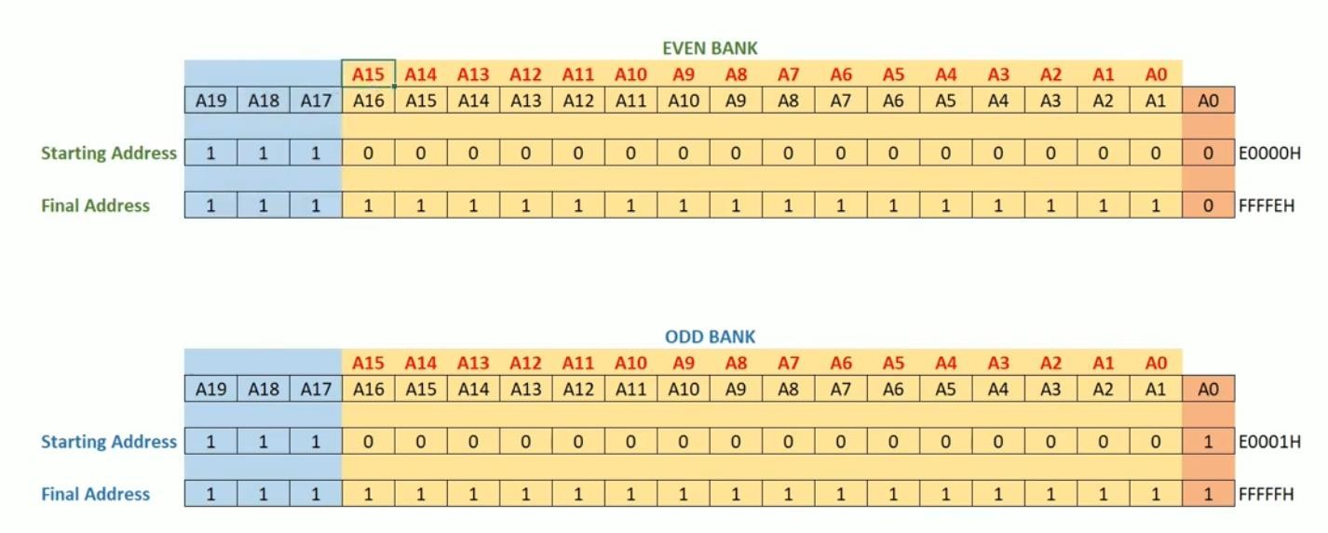
Exercise: 1

Slide 10
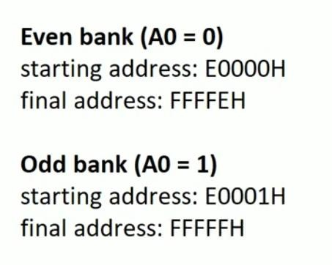
Exercise: 1

Slide 11
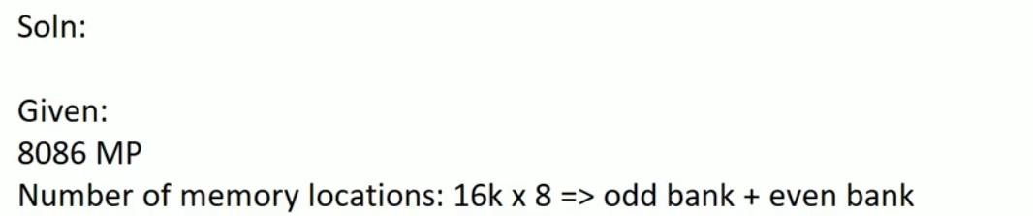
Exercise: 2
Interface 16k 8 memory locations for microprocessor 8086. The starting of the microprocessor is C0000H.

Slide 12
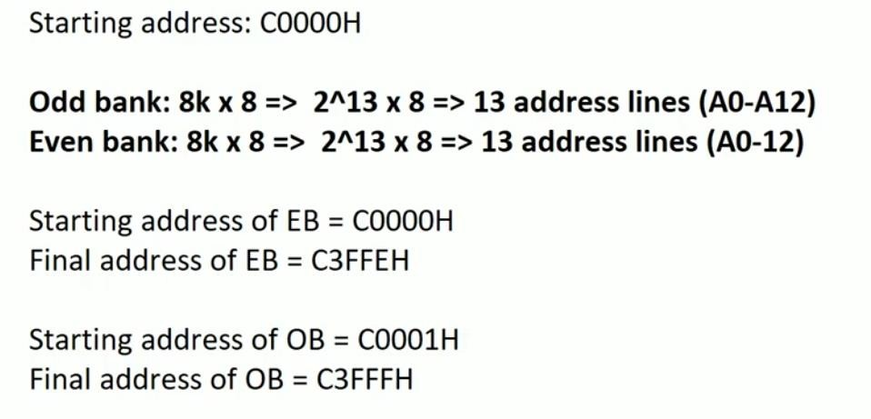
Exercise: 2

Slide 13
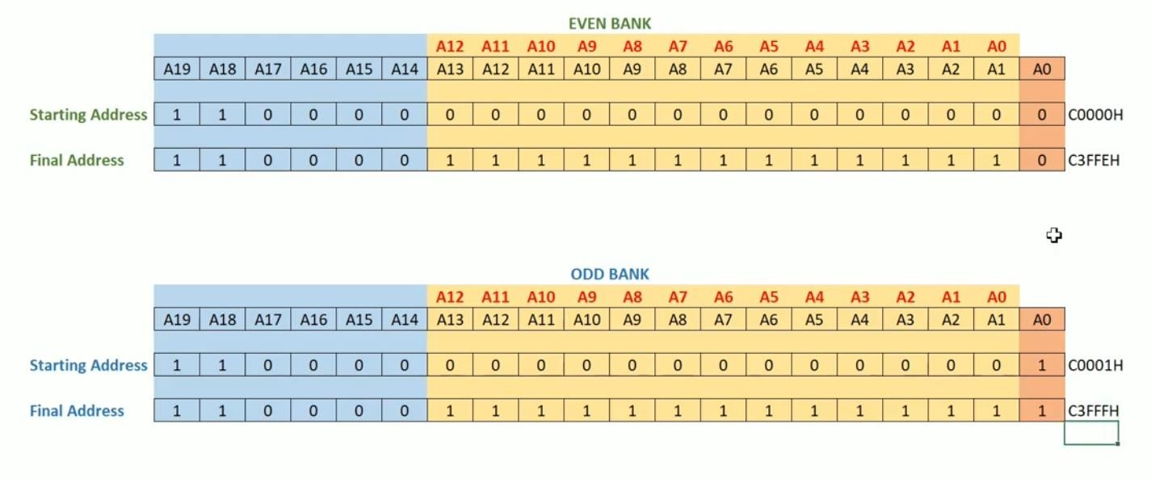
Exercise: 2

Slide 14
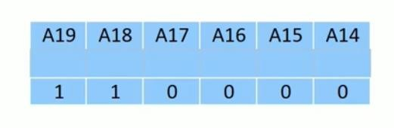
Exercise: 3
Interface 16k 8 memory locations for microprocessor 8086 using Multi-input NAND gate. The starting of the microprocessor is C0000H.
1st step: same as previous solution. Now, the fixed line inputs are

Slide 15
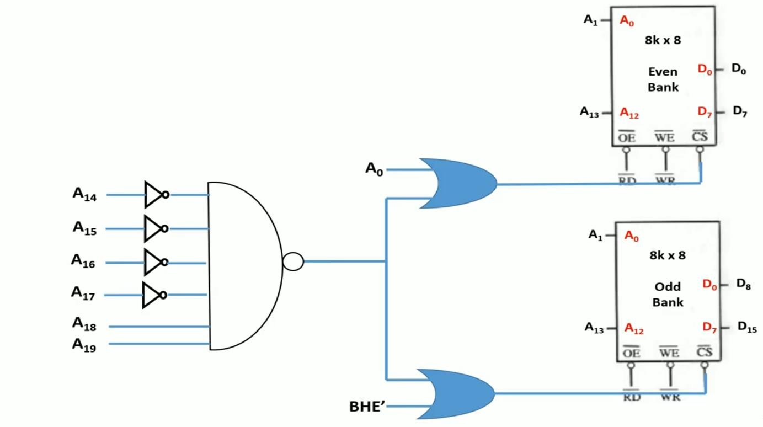
2nd step:

Slide 16
Exercise: 4
00000H
Interface two 4KX8 EPROM and two 4KX8 RAM chips with 8086.
RAM
ROM
Solution:
FFFFFH
Capacity of ROM for 2 Chips = 4K X 8 X 2 = 8K X 8 = 8KB
Consider, Ending Address of ROM = FFFFF H
Now, Size = 8KB = 2^3 X 2^10 = 2^13
So, 0000 0001 1111 1111 1111 = 01FFF H
Now, Starting Address of ROM = FFFFF H – 01FFF H = FE000 H
Again consider, Starting Address of RAM = 00000 H
For 4KB = 2^2X2^10 = 2^12
So, Address Lines = A1 – A12
A0=Bank Selection

Slide 17
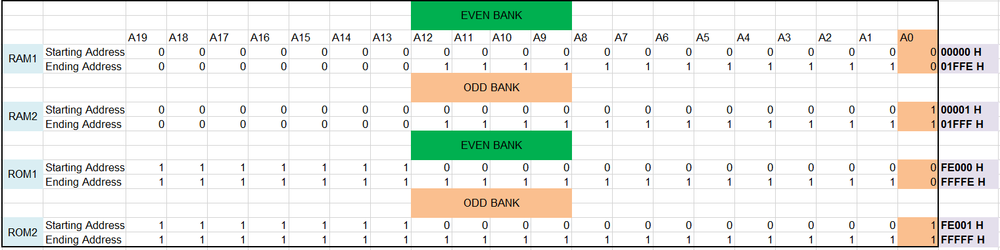
Exercise: 4

Slide 18
Exercise: 5
00000H
Interface 32KB ROM using 8 KB ROM and 32KB RAM using 16 KB chips with 8086.
RAM
ROM
Solution:
Required number of ROM = 32/8 = 4
Required number of RAM = 32/16 = 2
So, we need four 8KB ROM and two 16 KB RAM chips for interfacing
Consider, Ending Address of ROM = FFFFF H
Now, Size = 32KB = 2^5 X 2^10 = 2^15
So, 0000 0111 1111 1111 1111 = 07FFF H
Now, Starting Address of ROM = FFFFF H – 07FFF H = F8000 H
Again consider, Starting Address of RAM = 00000 H
For 16KB = 2^4X2^10 = 2^14
So, Address Lines = A1 – A14
A0=Bank Selection
FFFFFH

Slide 19
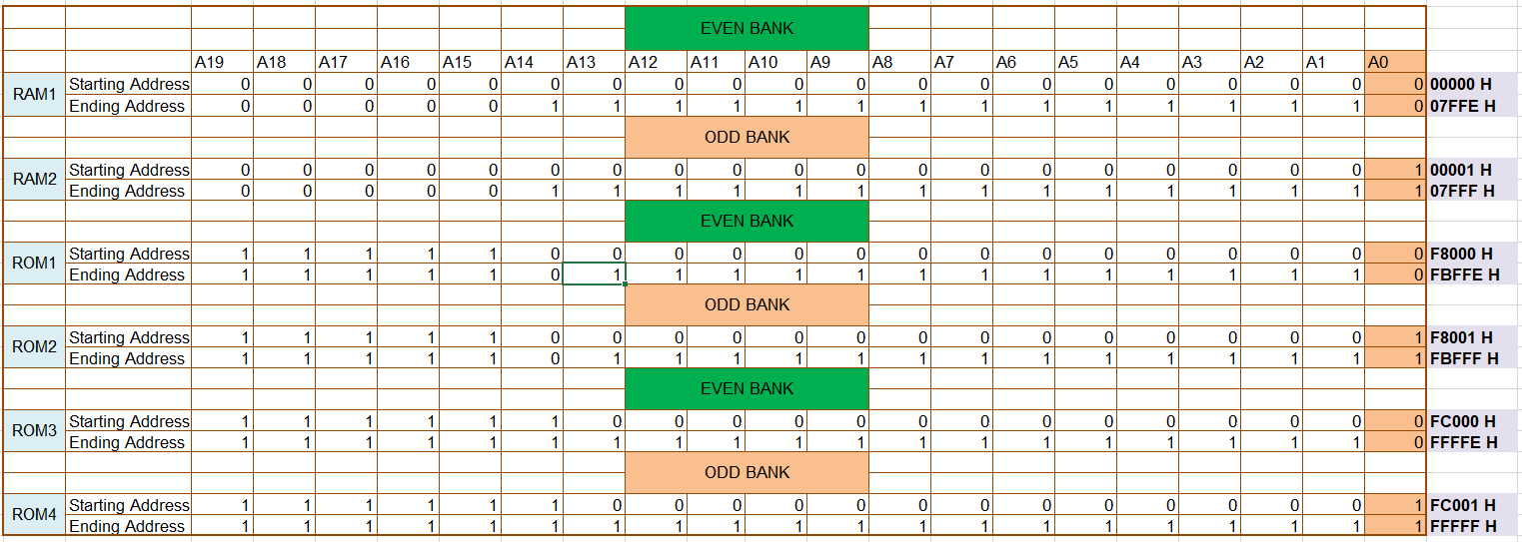
Exercise: 5

